Slide 1
Overview Autonomous Vehicles
Joseph E. Gonzalez
jegonzal@cs.berkeley.edu

Slide 2
What is the problem?
Driving is hard and wasteful.
Transportation is expensive.

Slide 4
Human Drivers are the Problem
In the United States (2016)
7,277,000 reported crashes
3,144,000 people were injured
37,461 fatalities (1 fatality every 14 minutes)
Leading cause of death for ages 16-22
94% of all crashes are due to human error
We should be working on this problem!
https://crashstats.nhtsa.dot.gov/Api/Public/ViewPublication/812580

Slide 5
Why now? Why us?
Sensing and actuation are (mostly) solved problems
Unlike many robotics tasks
Limited by perception (alg.) and compute (arch./sys.)
Current research focus is on AI
Needed for advanced autonomy
AI needed for collision avoidance is partly ready
Gap in research on systems side
Needed: software and hardware platform of an autonomous vehicles
Keep device costs down while enabling innovation
Challenges to entry
Data and test platform → simulation is improving + Berkeley test vehicles

Slide 6
Basics of Autonomous Vehicles

Slide 7
Levels of Autonomy: Automotive Engineering Society (AES) Standard
 | Name | Description | Steering & Accel. | Env. Monitor | Fallback
1 | Driver Assistance | Assistance for either steering or acceleration using information about env. with the expectation that human performs all remaining aspects. | Human + System | Human | Human
2 | Partial Automation | Assistance for both steering and acceleration using information about env. with the expectation that human performs all remaining aspects. | System | Human | Human
3 | Conditional Automation | Autonomous driving with the expectation that human will respond to a request to intervene | System | System | Human
4 | High Automation | Autonomous driving with the ability to take a safe action (e.g., pull over) if a human cannot intervene. | System | System | System
5 | Full Automation | Autonomous driving under all feasible roadway and environmental conditions. | System | System | System

Slide 8
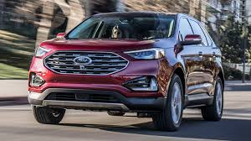
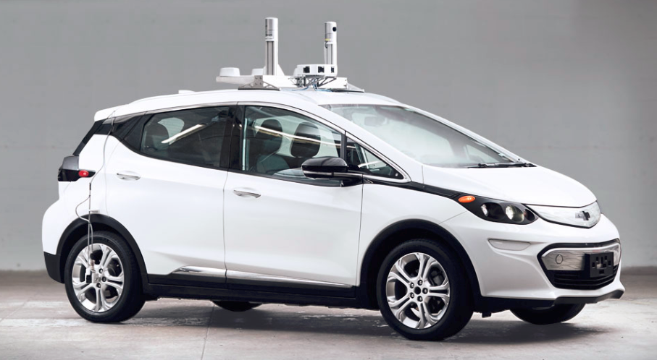
Advanced Driver Assistance Systems (ADAS) vs Autonomous Vehicles
Level 1– Level 3 ADAS Systems
Level 4 – Level 5 Autonomy
L1: Individual assistance functions
Collision warning
Pedestrian detection
Automatic emergency braking
Lane detection, lane assist
Parking assist
L2: combining them
L3: vehicle takes over driving functions, but driver must be ready to take over
Levels of Full Autonomy
Level 4
Full autonomy in constrained situations
Level 5
Fully autonomous in all situations

Slide 9
Cartoon Autonomous Vehicles Pipeline
Sensing
Perception
Prediction
Cameras
Object Det.
Current
State
LiDAR
Lane Detection
Planning
Control
Radar
Path Planning
Steering
Localization
Prediction
IMU
Specialized
Scenarios
Accel & Breaking
GPS
Pose Est.
Future
States

Slide 10
Tesla Sensor Package

Slide 11
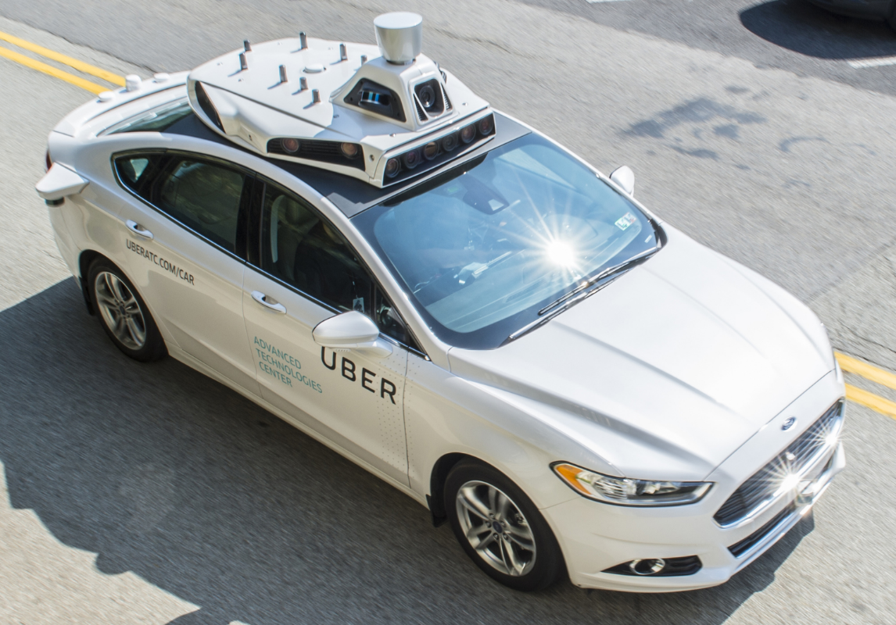
Sensors – Top View
360° LiDAR
Camera array
Stereo camera pairs
LiDAR
& Radar

Slide 12
Waymo

Slide 13
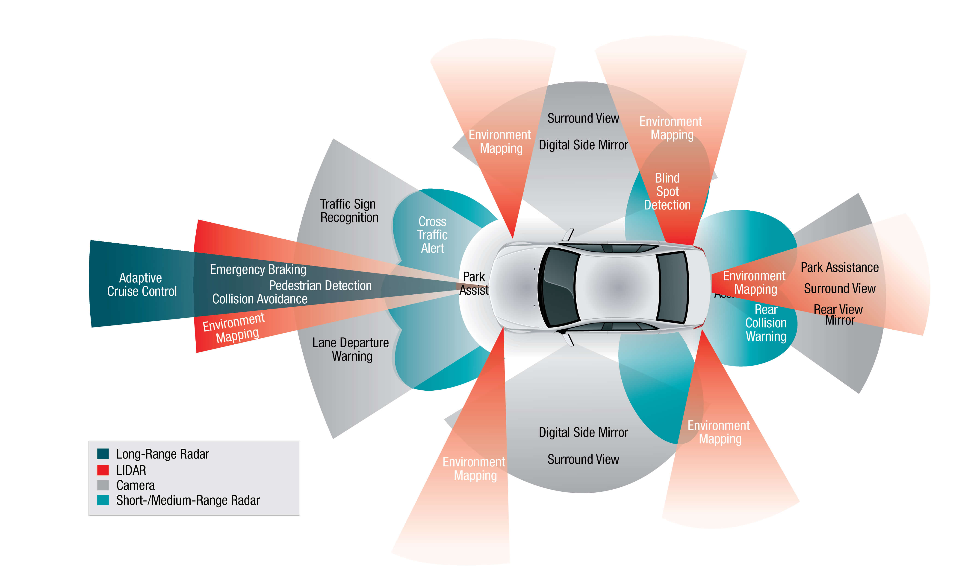
Sensors and Their Uses

Slide 14
Sensor Comparison
Sensor | Relative Cost | Resolution | Strengths | Weaknesses
LiDAR | Highest | Mid-range | Depth data 360° view | Susceptible to weather (fog, rain, snow etc.)
Camera | Least expensive | Highest | Traffic lights, pedestrians, signage | Darkness, glare, fog,
RADAR | Cheap | Low | Robust in bad weather | Low Resolution
SONAR | Cheap | Very low | Robust in weather, darkness, brightness | Very Short Range

Slide 15
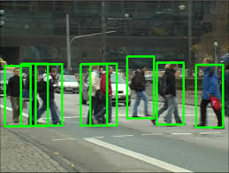
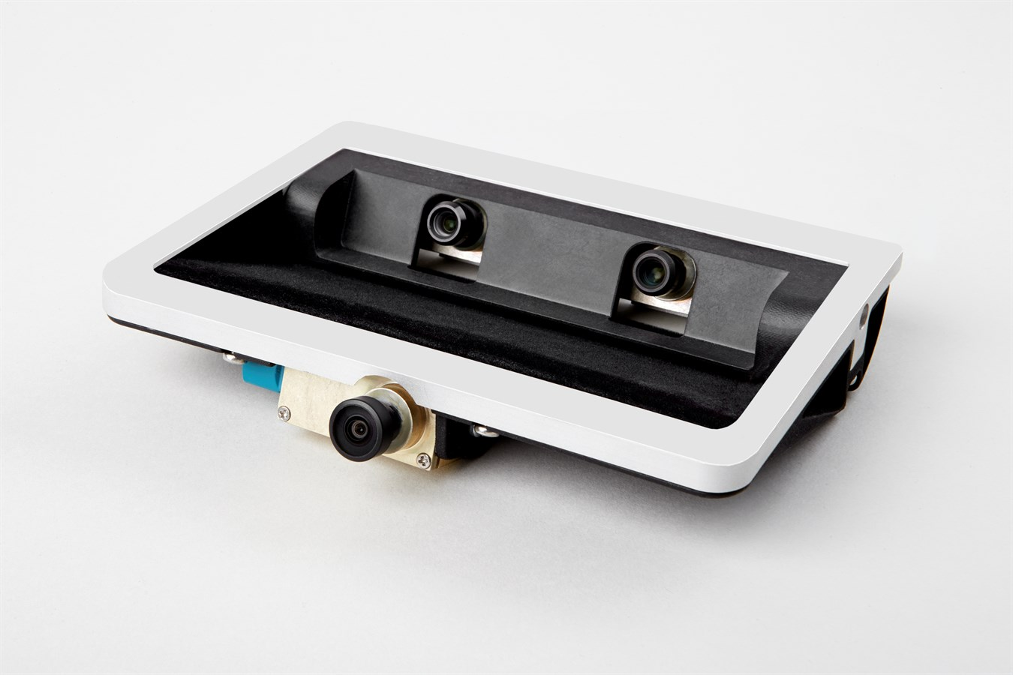
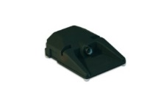
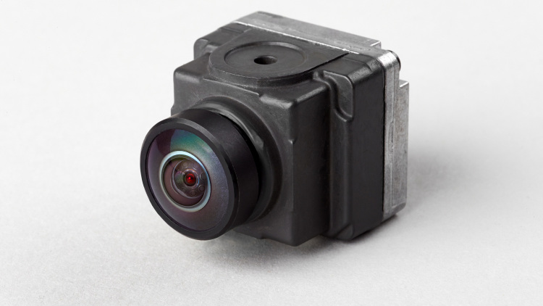
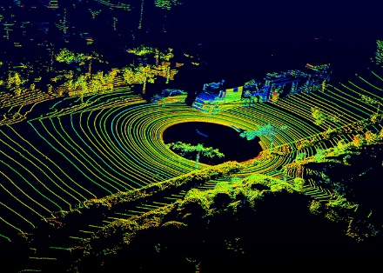
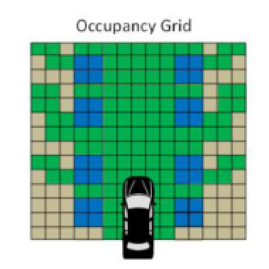
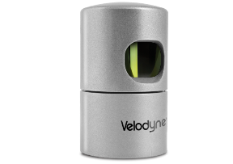

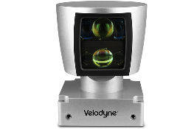

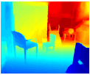
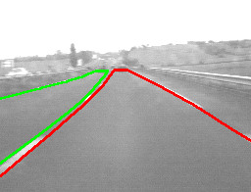
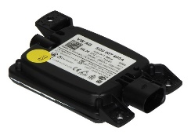
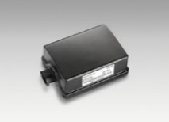
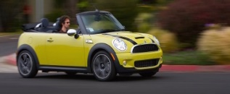
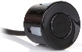
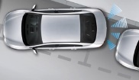
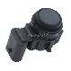
Applying DNN to Integrated Sensor Data
Object Detection
CAMERAS
Integrating
Multiple
Sensors
Point cloud
Occupancy Grid
LIDAR
RGB-D image
Lane Segmentation
RADAR
ULTRASONIC
(short-range)
Object Tracking
Notes:
Learning-Defined Sensor Fusion
We're using DL rather than straight SW
Sensor Virtualization

Slide 16
Typical Approach to State Representation
Current
State
Accurate 3D Models
Individual object detection localization, and pose estimation
High-resolution maps
Object trajectories
11.3 m
12.1m
10.6 m
8.2m
4.3m
6.5m

Slide 17
Waymo

Slide 18
Cartoon Autonomous Vehicles Pipeline
Sensing
Perception
Prediction
Cameras
Object Det.
Current
State
LiDAR
Lane Detection
Planning
Control
Radar
Path Planning
Steering
Localization
Prediction
IMU
Specialized
Scenarios
Accel & Breaking
GPS
Pose Est.
Future
States

Slide 19
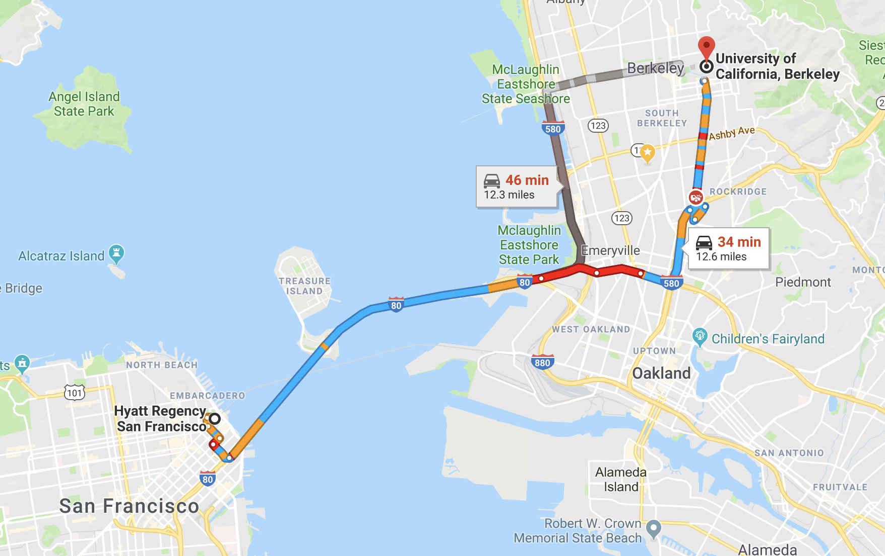
Classic Hierarchical Approach
Decompose motion planning and control into stages
Route Planning
Behavior Planning
Path Planning
Local Control
Exit
Ramp
Merge
Right
Merge Left
Follow
Lane
Overtake
Park
Yield to
Ped.
Sequence of roads and intersections
Target State Configurations
Detailed Path to Follow
Road Networks Traffic Information
Obstacles …
Model of the world around the car including predicted future states.
Model of the vehicle’s dynamics.
Notes:
Path planning image courtesy of http://www.smart2zero.com/news/elektrobit-rolls-four-more-software-modules-autonomous-driving
Control image courtesy of https://www.egypt-business.com/Ticker/details/1738-Worldwide-Electronic-Stability-Control-ESC-Market-Growth-Projection-to-2021/159246

Slide 20
The Architectural Implications of Autonomous Driving
Presented by Sukrit
Sensing
Perception
Prediction
Cameras
Object Det.
Current
State
LiDAR
Lane Detection
Planning
Control
Radar
Path Planning
Steering
Localization
Prediction
IMU
Specialized
Scenarios
Accel & Breaking
GPS
Pose Est.
Future
States
ChauffeurNet: Learning to Drive by Imitating the Best and Synthesizing the Worst
Presented by Dequan
Previous
Computer Vision Reading

Slide 21
Readings today
The Architectural Implications of Autonomous Driving
Presented by Sukrit
ChauffeurNet: Learning to Drive by Imitating the Best and Synthesizing the Worst
Presented by Dequan
Discussion about research opportunities and challenges

Slide 22
Route Planning
Determine best route between origin and destination
survey “Route Planning in Transportation Networks”
Input: source and destination as well as the road network, traffic information, obstacles
Output: Sequence of roads (paths) including GPS coordinates.
Relies on optimizations of classic graph algorithms to plan in seconds across entire contents.
Route Planning
Google Maps
Apple Maps
Big Maps
Sequence of roads and intersections
Road Networks Traffic Information
Obstacles …

Slide 23
Classic Hierarchical Approach
Decompose motion planning and control into stages
Route Planning
Behavior Planning
Path Planning
Local Control
Exit
Ramp
Merge
Right
Merge Left
Follow
Lane
Overtake
Park
Yield to
Ped.
Sequence of roads and intersections
Target State Configurations
Detailed Path to Follow
Road Networks Traffic Information
Obstacles …
Model of the world around the car including predicted future states.
Model of the vehicle’s dynamics.
Notes:
Path planning image courtesy of http://www.smart2zero.com/news/elektrobit-rolls-four-more-software-modules-autonomous-driving
Control image courtesy of https://www.egypt-business.com/Ticker/details/1738-Worldwide-Electronic-Stability-Control-ESC-Market-Growth-Projection-to-2021/159246

Slide 24
Behavior Planning
Determines the high-level actions need to move through the input road network in response to observations and future state predictions.
Example:
Exit right from parking lot.
Merge into left lane
Turn left at intersection
Avoid [observed] construction worker ...
Inputs: Road sequence as well as observations and predictions from perception systems.
Outputs: Actions which can be mapped to state configurations (e.g., GPS waypoints, orientation, speed…)
Solutions: Finite state machines as well as probabilistic generalizations (MDPs).
Area of potential future innovation → Learned behaviors
Behavior Planning
Exit
Ramp
Merge
Right
Merge Left
Follow
Lane
Overtake
Park
Yield to
Ped.
Sequence of roads and intersections
Target State Configurations

Slide 25
Classic Hierarchical Approach
Decompose motion planning and control into stages
Route Planning
Behavior Planning
Path Planning
Local Control
Exit
Ramp
Merge
Right
Merge Left
Follow
Lane
Overtake
Park
Yield to
Ped.
Sequence of roads and intersections
Target State Configurations
Detailed Path to Follow
Road Networks Traffic Information
Obstacles …
Model of the world around the car including predicted future states.
Model of the vehicle’s dynamics.
Notes:
Path planning image courtesy of http://www.smart2zero.com/news/elektrobit-rolls-four-more-software-modules-autonomous-driving
Control image courtesy of https://www.egypt-business.com/Ticker/details/1738-Worldwide-Electronic-Stability-Control-ESC-Market-Growth-Projection-to-2021/159246

Slide 26
Path Planning
Compute an “optimal” sequence of state configurations (e.g., locations and velocities) that terminates in the desired end state.
Path: sequence of state configurations including
Position, orientation, velocity
Optimal
Feasible with respect to vehicle dynamics
Avoid collisions or violating road laws
Comfortable (limited acceleration, jerk, …)
Efficient (reduce wasted energy and time)
Dependencies
Road network
Behavior of other vehicles and pedestrians
Vehicle dynamics model
Hard problem but well studied!
Path Planning
Target State Configurations
Detailed Path to Follow

Slide 27
Vehicle Dynamics Models
Typically adopt simplified physical model of vehicle dynamics that capture constraints on the velocity and acceleration of the vehicle to determine feasible paths.
Common Dynamics Models
Feasible
Single Track No Slip
Single Track with Frictional Forces
Infeasible
Infeasible
Used in low speed settings
(e.g., Parking)
Needed for driving at higher speeds.
(e.g., highway driving)
Illustrations of dynamics models from “A Survey of Motion Planning and Control Techniques for Self-driving Urban Vehicles”
Notes:
Note that vehicle stability control systems often use even more elaborate models that capture the frame and tire stiffness and cornering characteristics of the vehicle.

Slide 28
Optimal Path Planning Problem
Optimization Problem:
Path Objective Function
Comfort + Safety
path
Set of all continuous paths
Path terminates in a goal state (e.g., car is parked)
Constraints:
Solving the general problem is PSPACE-hard
☹
The path remains in the drivable space
(obeys laws and doesn’t hit obstacles)
Differential Constraints on path curvature (given by vehicle dynamics)
Notes:
Pspace-Hard means it is at least as hard as an NP-complete problems.

Slide 29
Approximate Solutions to Optimal Path Planning
Variational Methods
Graph Search Methods (commonly used)
Discretize space of possible paths and optimize
Regular Lane or Geometric Graphs
Approximate smooth paths with parametric functions (e.g., splines) and optimize control points.
Get stuck in local minima
Random or Incremental Graphs

Slide 30
Classic Hierarchical Approach
Decompose motion planning and control into stages
Route Planning
Behavior Planning
Path Planning
Local Control
Exit
Ramp
Merge
Right
Merge Left
Steering Angle
Acceleration
Follow
Lane
Overtake
Park
Yield to
Ped.
Sequence of roads and intersections
Target State Configurations
Detailed Path to Follow
Road Networks Traffic Information
Obstacles …
Model of the world around the car including predicted future states.
Model of the vehicle’s dynamics.
Notes:
Path planning image courtesy of http://www.smart2zero.com/news/elektrobit-rolls-four-more-software-modules-autonomous-driving
Control image courtesy of https://www.egypt-business.com/Ticker/details/1738-Worldwide-Electronic-Stability-Control-ESC-Market-Growth-Projection-to-2021/159246

Slide 31
Classic Hierarchical Approach
Decompose motion planning and control into stages
Route Planning
Behavior Planning
Path Planning
Local Control
Exit
Ramp
Merge
Right
Merge Left
Steering Angle
Acceleration
Follow
Lane
Overtake
Park
Yield to
Ped.
Sequence of roads and intersections
Target State Configurations
Detailed Path to Follow
Road Networks Traffic Information
Obstacles …
Model of the world around the car including predicted future states.
Model of the vehicle’s dynamics.
Notes:
Path planning image courtesy of http://www.smart2zero.com/news/elektrobit-rolls-four-more-software-modules-autonomous-driving
Control image courtesy of https://www.egypt-business.com/Ticker/details/1738-Worldwide-Electronic-Stability-Control-ESC-Market-Growth-Projection-to-2021/159246

Slide 32
Local Control
Basis for established technologies like electronic stability control
Use classic closed-loop controllers to actuate steering and acceleration along the planned path
Requires frequent control responses (real-time system) to correct for errors.
Common techniques often adopt locally linear approximations to the system
PID Controllers: Proportional-–integral—derivative controller corrects the steering and acceleration proportional to their deviation with damping
Linear Quadratic Regulators: Optimally controls a linear approximation of the system.
Local Control
Steering Angle
Acceleration

Slide 33
Classic Hierarchical Approach
Decompose motion planning and control into stages
Route Planning
Behavior Planning
Path Planning
Local Control
Exit
Ramp
Merge
Right
Merge Left
Follow
Lane
Overtake
Park
Yield to
Ped.
Sequence of roads and intersections
Target State Configurations
Detailed Path to Follow
Road Networks Traffic Information
Obstacles …
Model of the world around the car including predicted future states.
Model of the vehicle’s dynamics.
More details can be found here in “A Survey of Motion Planning and Control Techniques for Self-driving Urban Vehicles”
Notes:
Path planning image courtesy of http://www.smart2zero.com/news/elektrobit-rolls-four-more-software-modules-autonomous-driving
Control image courtesy of https://www.egypt-business.com/Ticker/details/1738-Worldwide-Electronic-Stability-Control-ESC-Market-Growth-Projection-to-2021/159246

Slide 34
Classic Hierarchical Approach
Decompose motion planning and control into stages
Route Planning
Behavior Planning
Path Planning
Local Control
Exit
Ramp
Merge
Right
Where is the machine learning?
How are we using data?
Merge Left
Follow
Lane
Overtake
Park
Yield to
Ped.
Sequence of roads and intersections
Target State Configurations
Detailed Path to Follow
Road Networks Traffic Information
Obstacles …
Model of the world around the car including predicted future states.
Model of the vehicle’s dynamics.
More details can be found here in “A Survey of Motion Planning and Control Techniques for Self-driving Urban Vehicles”
Notes:
Path planning image courtesy of http://www.smart2zero.com/news/elektrobit-rolls-four-more-software-modules-autonomous-driving
Control image courtesy of https://www.egypt-business.com/Ticker/details/1738-Worldwide-Electronic-Stability-Control-ESC-Market-Growth-Projection-to-2021/159246

Slide 35
End-to-End Control (Behavior Cloning)
Imitation Learning
& Reinforcement Learning
Sensing
Advantages:
Leverage large quantities of driving data without annotation
Address complex scenarios without hand coded heuristics
Disadvantages:
Requires substantial data in good and bad scenarios
Doesn’t leverage domain knowledge
Cameras
Deep Learning
Steering
LiDAR
Radar
IMU
Accel & Breaking
GPS

Slide 36
ALVINN 1989
Autonomous Land Vehicle in a Neural Network
Trained in simulation could follow some roads.

Slide 37
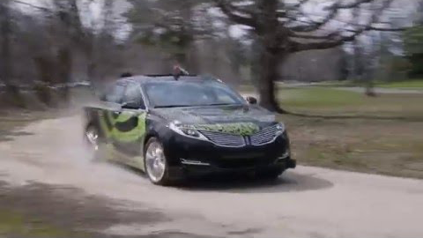
Nvidia DAVE-2 System (2016)
Trained a deep neural network to control steering by behavior cloning (supervised loss).
Notes:
https://www.youtube.com/watch?v=qhUvQiKec2U

Slide 38
Limitations of End-to-End Approach
Doesn’t leverage physical models of vehicle control
Forced to learn and reason about scenes from driving supervision
Model must learn the concepts of people, vehicles, obstacles directly from driving behavior demonstrations
Often doesn’t perform well in new situations
Earlier examples were focused on the simple task of staying in the lane
Hybrid Approach
Leverage output of perception as well as the classic planning and control hierarchy and instead learn to output paths as a function of the output of perception.
Example: Waymo ChauffeurNet

Slide 39
ChauffeurNet
Rasterized Encoding of Current and Predicted States
Produced by Perception Pipelines
Convolutional
Predict future states of the world
ChauffeurNet: Learning to Drive by Imitating the Best and Synthesizing the Worst

Slide 40
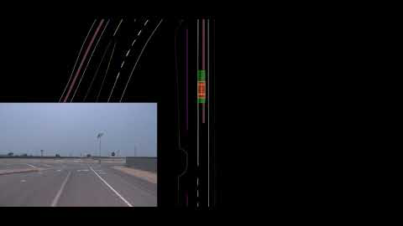
ChauffeurNet Examples

